Slide 1
Power bi is Business Intelligence tool

Slide 2
Power Query
PowerPivot
Power View
Power BI Service

Slide 3
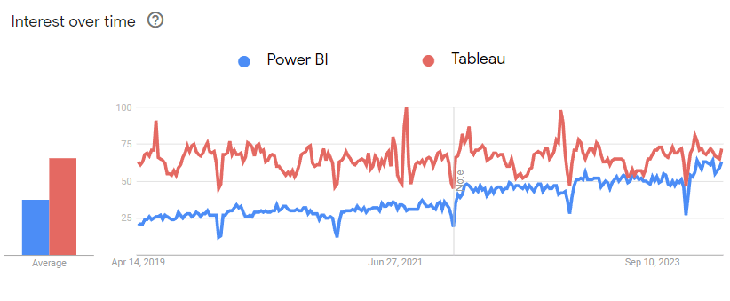
Growth

Slide 4
Features Cost is cheapest Data connectivity

Slide 5
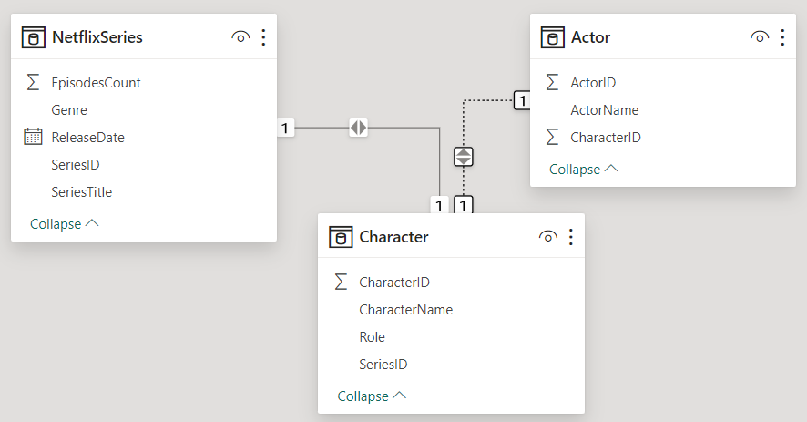
Power Bi Desktop
Developer Application
Power Bi Services
Deploy the reports
Power Bi Mobile
Power Bi Desktop
Report view(VIEW)
Table View
Power query(Transformation)
Modelling
DAX

Slide 6
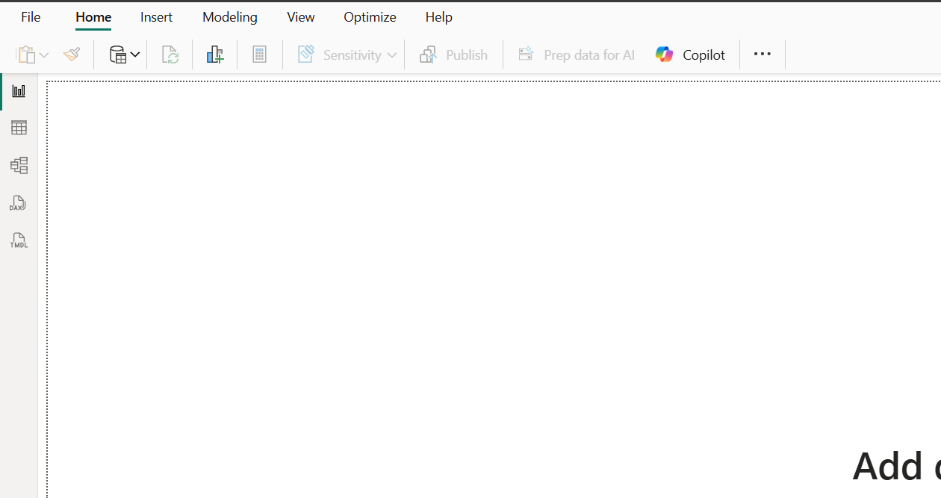
Report View (Bar chart icon): Used to create and view your report visualizations.
Table View (Grid icon): Used to view and manage the data within your tables.
Model View (Relationship diagram icon): Used to manage relationships between different data tables.
DAX Query View (Document icon with "DAX"): Used to write and run DAX (Data Analysis Expressions) queries.
TMDL View (Document icon with "TMDL"): Used for working with Tabular Model Definition Language files.

Slide 7
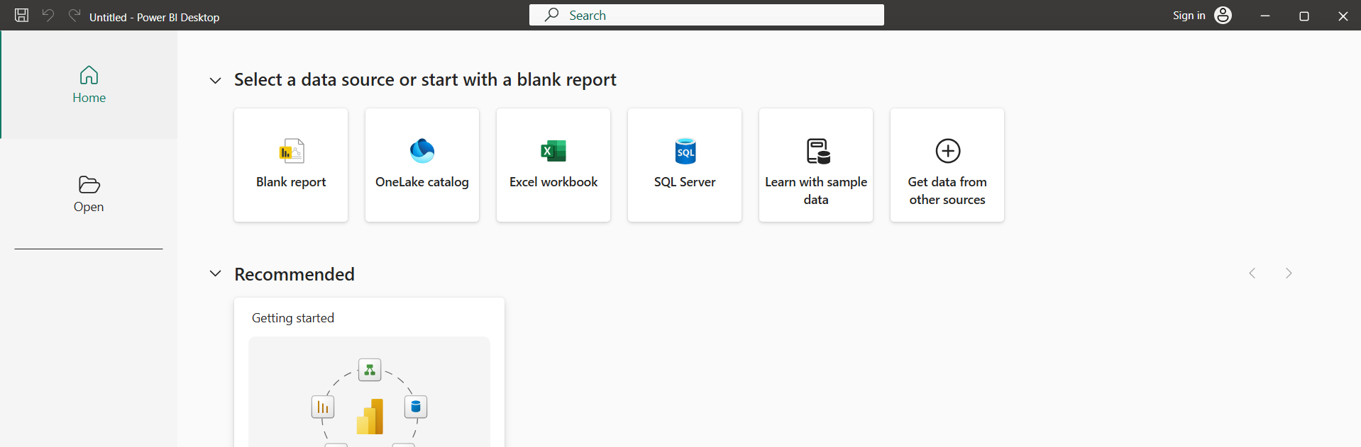
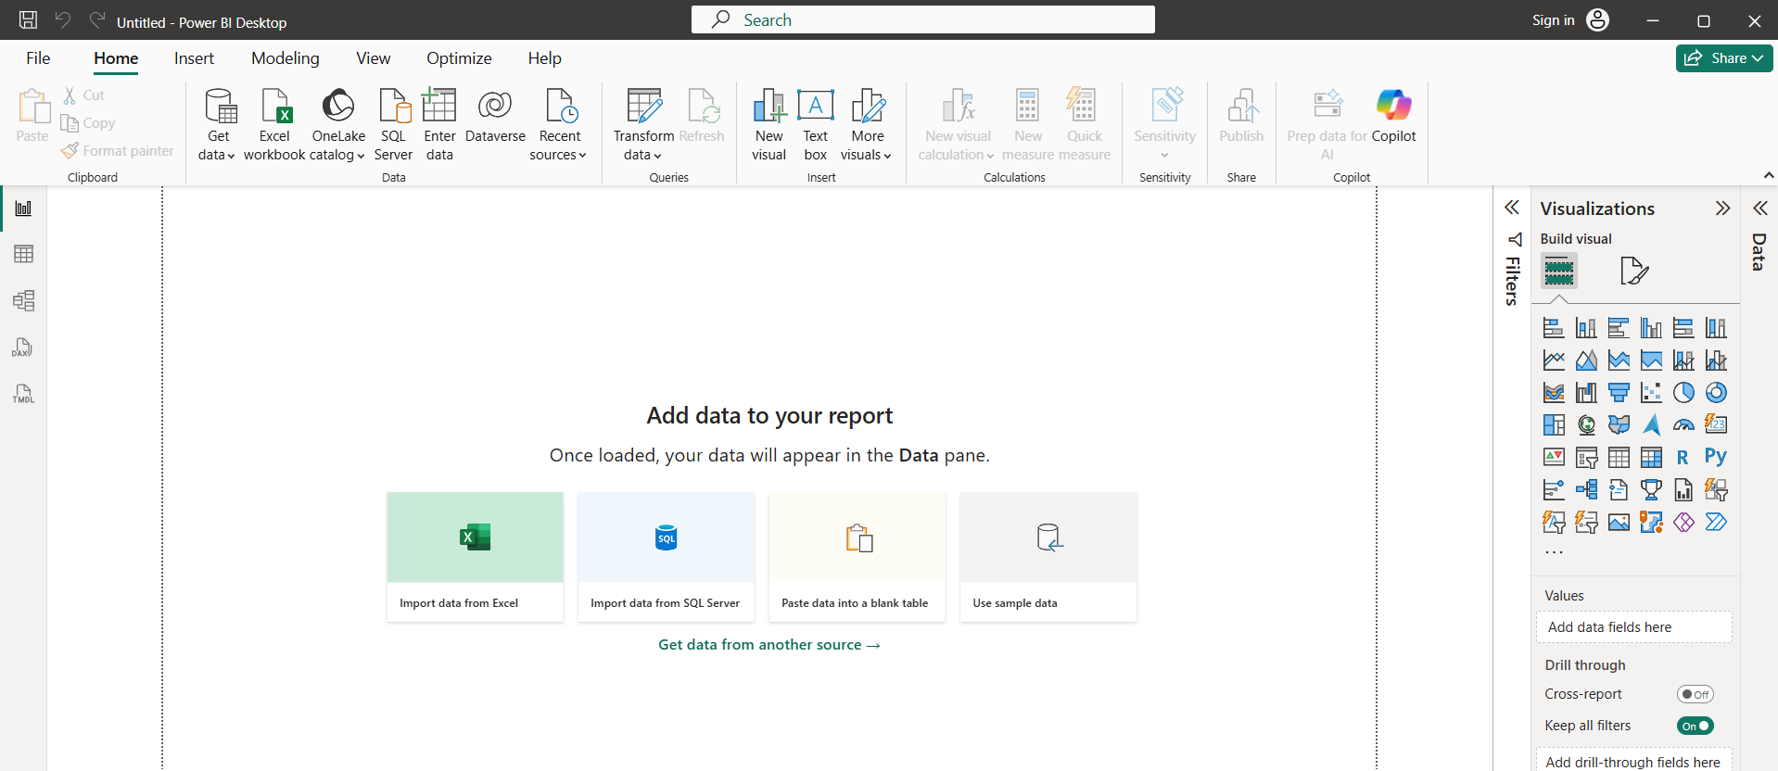

Slide 8
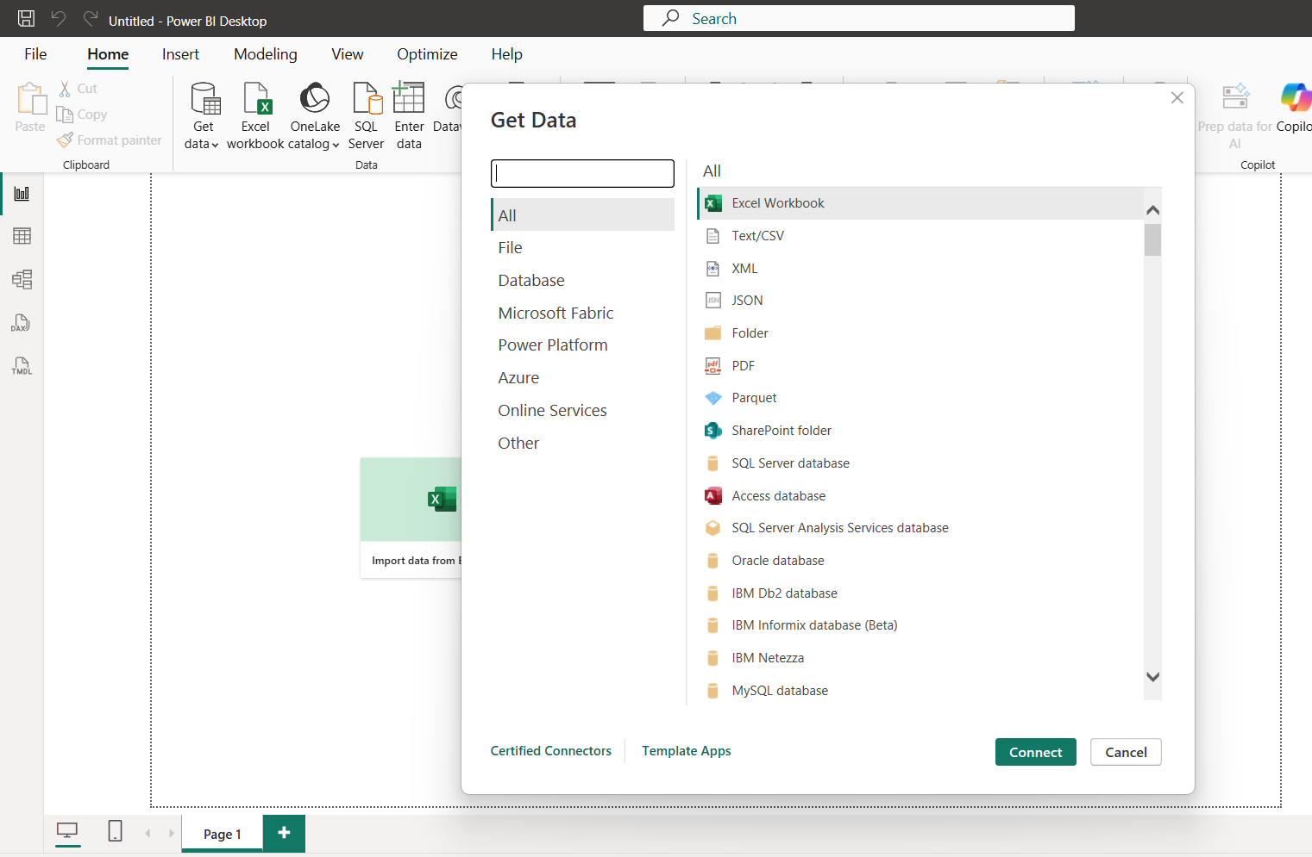

Slide 9
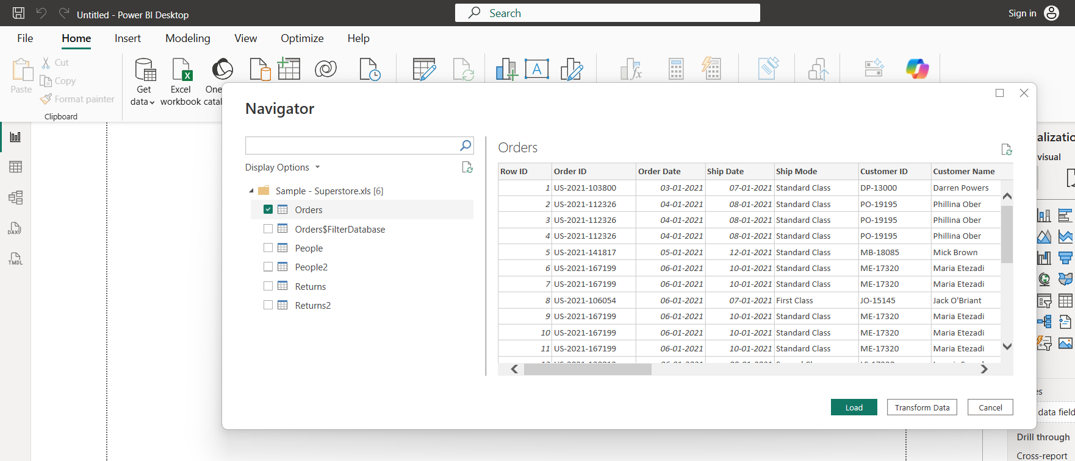

Slide 10
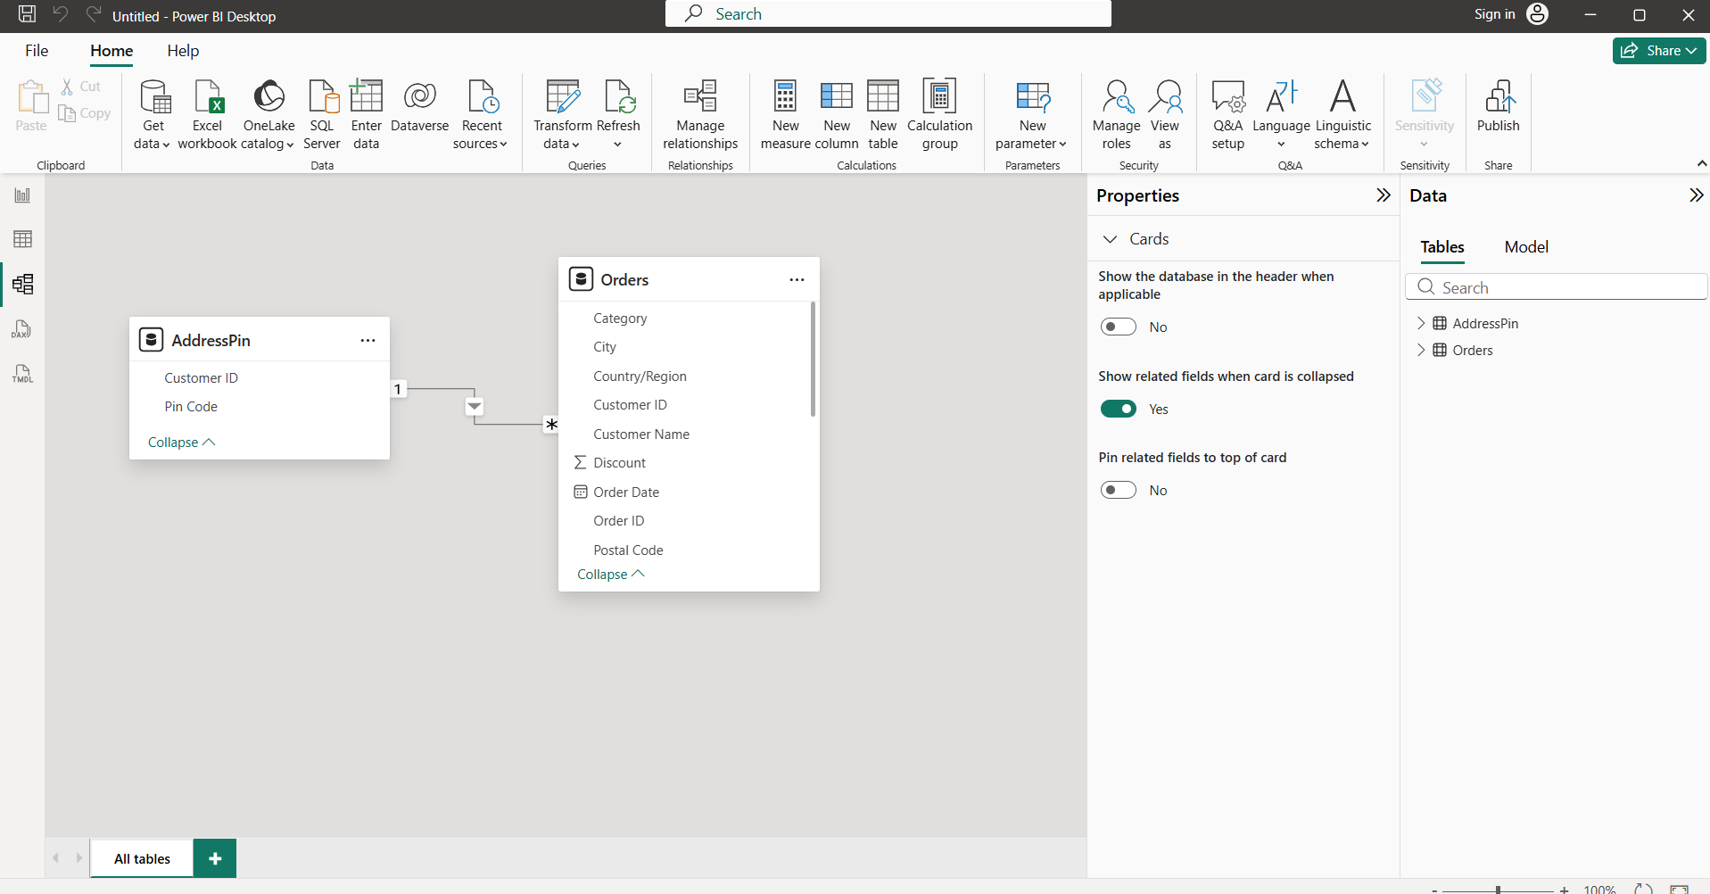
Model View

Slide 11
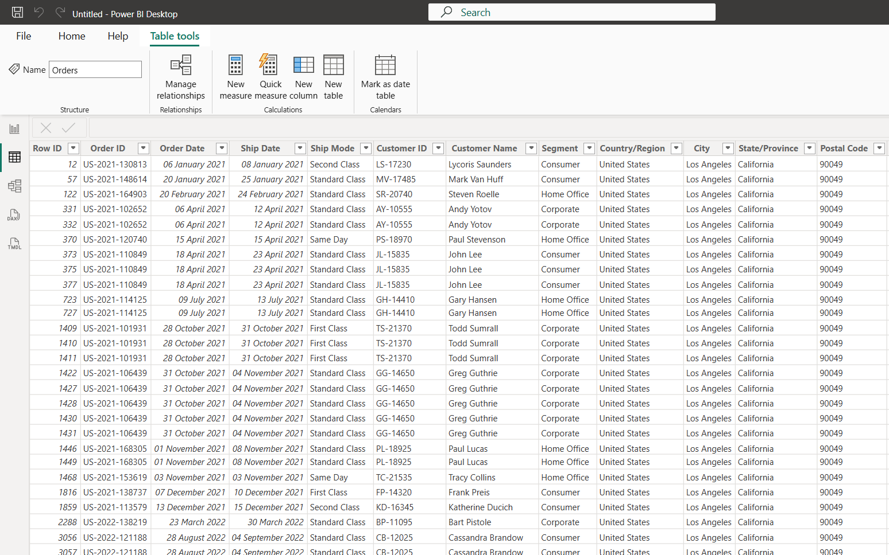
Data

Slide 12
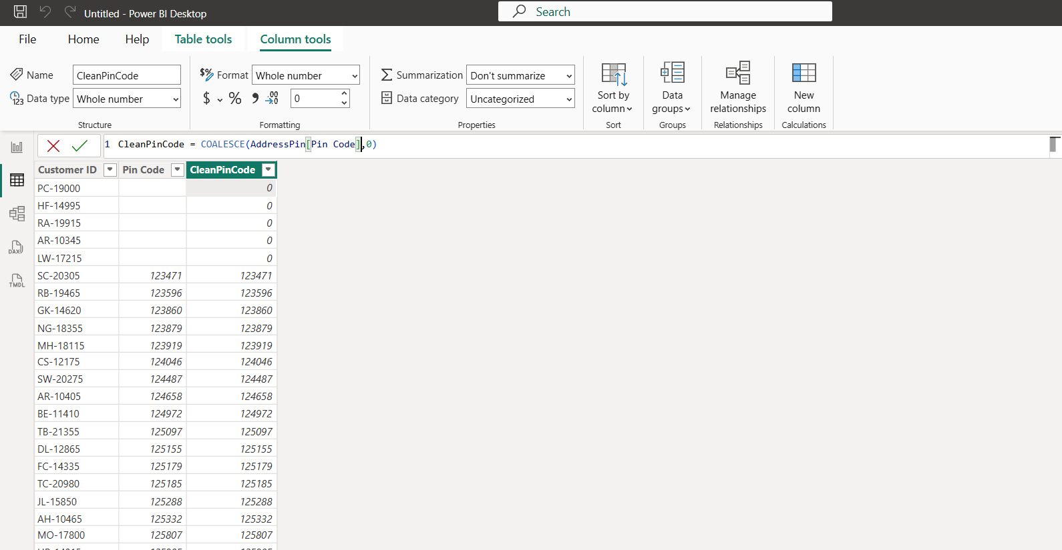
DAX

Slide 13
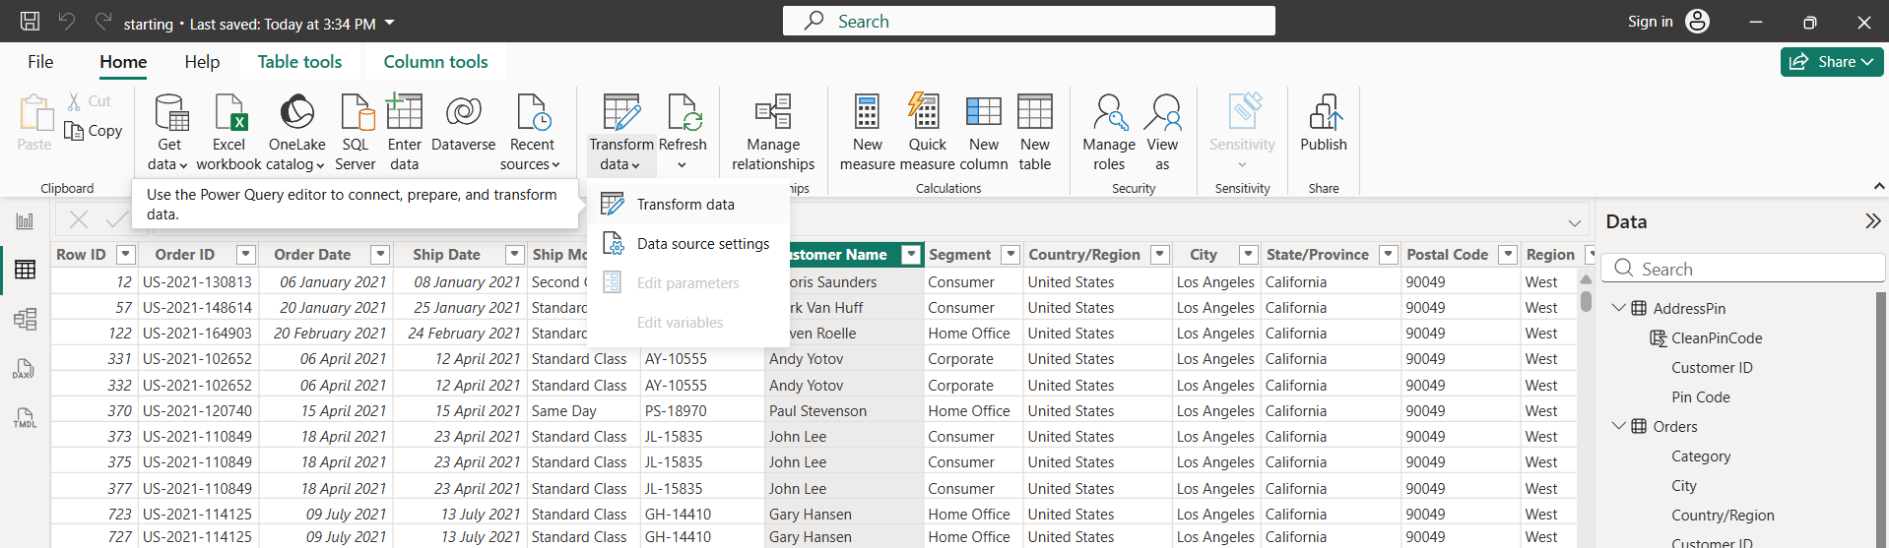
Transform

Slide 15
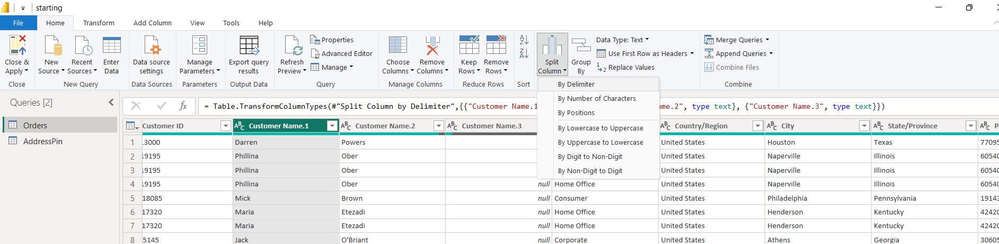
Power Query

Slide 16
Data Modelling
Relationships Cardinality & Cross Filter Direction :
Star Schema vs. Snowflake Schema: Structural organization of Fact and
Dimension tables.
Creating & Managing Relationships: Active vs. inactive relationship paths.
Date Table Creation: Generating continuous calendar dimensions for Time
Intelligence functions.
Hierarchies:
Parent-child drill-down paths (e.g., Year > Quarter > Month > Day).

Slide 17
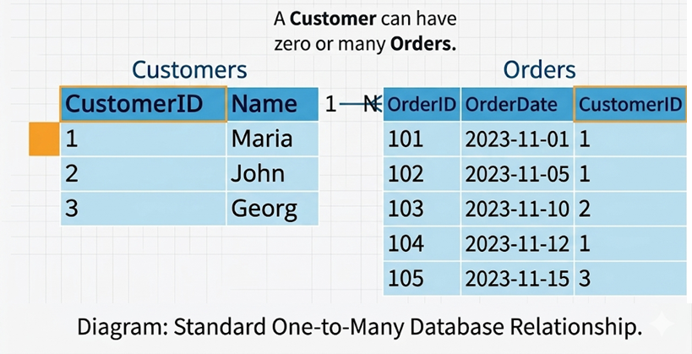
Relationships:
One-to-many
One to One
Many to Many
One-to-many

Slide 18
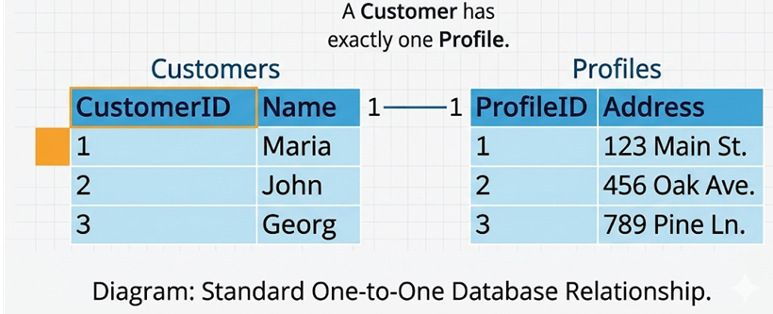
One-to-One

Slide 19
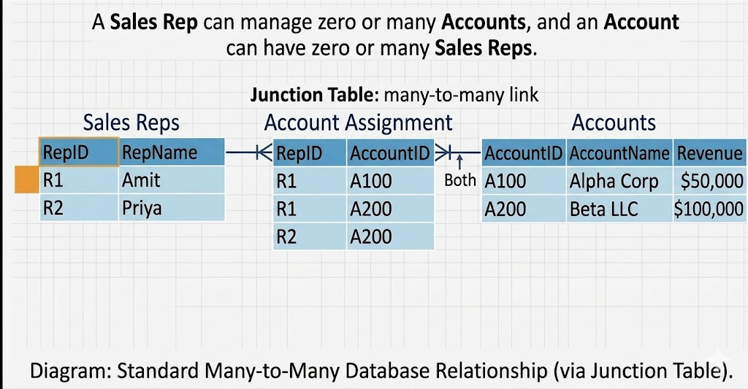
Many to Many

Slide 20
Star Schema vs. Snowflake Schema:
Before we go for Star Schema and Snowflake Schema 1st we need to understand what is Fact Table and Dimension Table

Slide 21
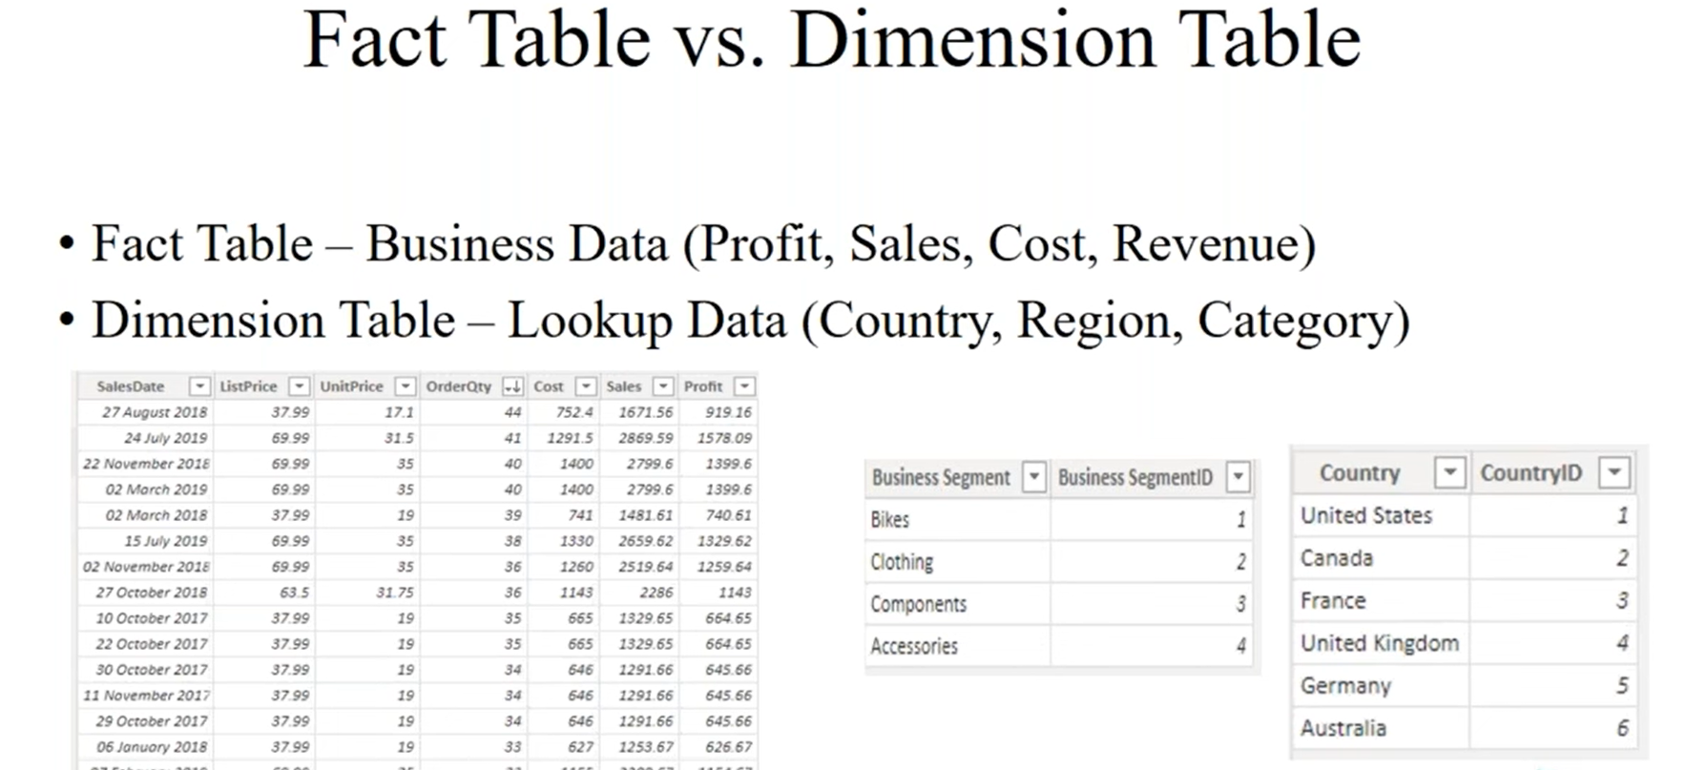
Fact Table: Stores quantitative, measurable metrics and foreign keys, recording specific business events or transactions (e.g., sales revenue, quantity sold).
Dimension Table: Stores descriptive attributes and context about the facts, allowing users to filter, group, and label data (e.g., customer names, product categories, dates).

Slide 22
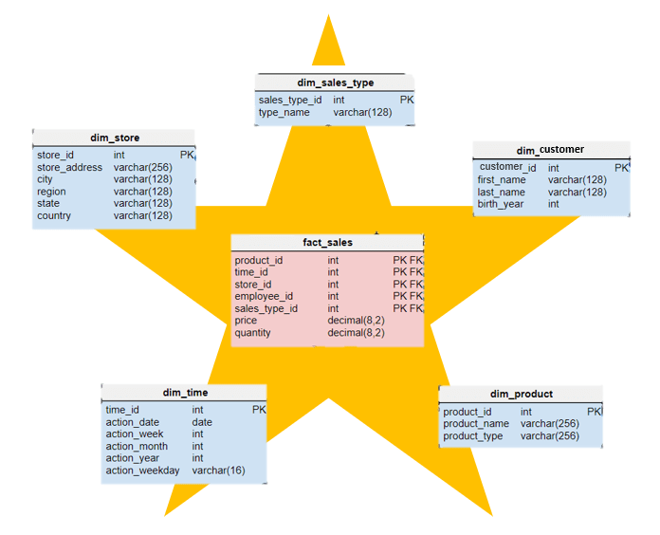
Star Schema
Every Dimension table is connected to the Fact Table.

Slide 23
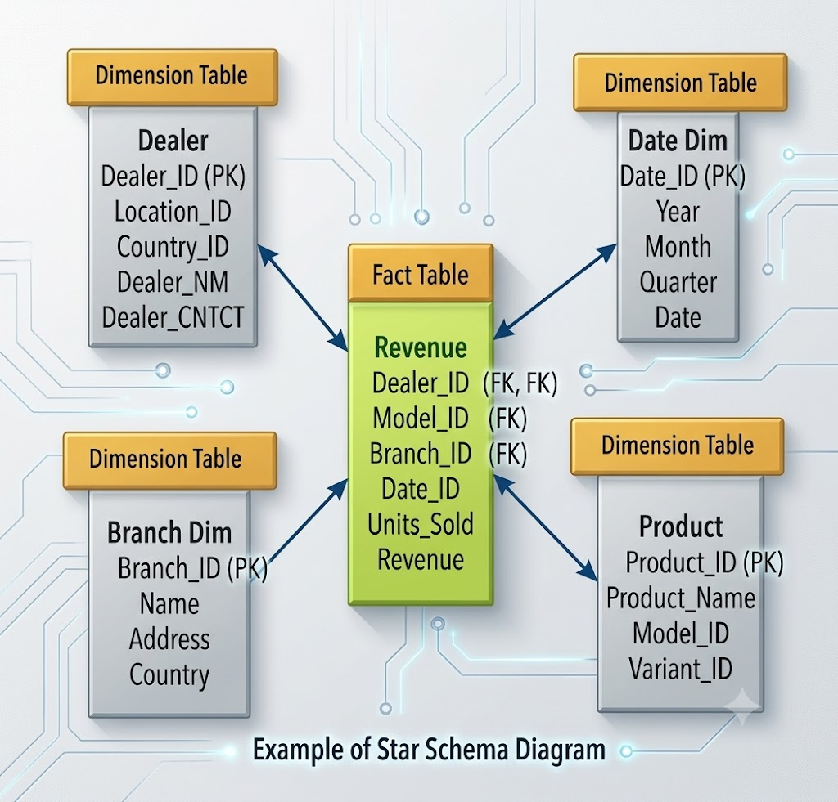
Every Dimension table is connected to the Fact Table.

Slide 24
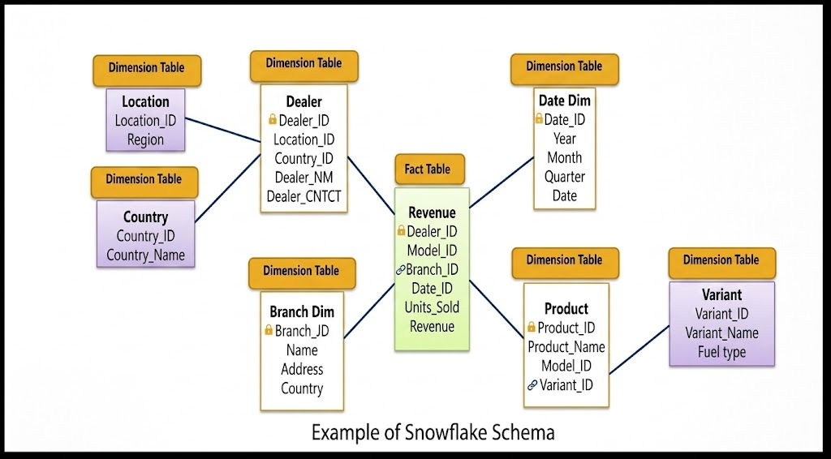
Snowflake Schema:

